Slide 1
Null Hypothesis

Slide 2
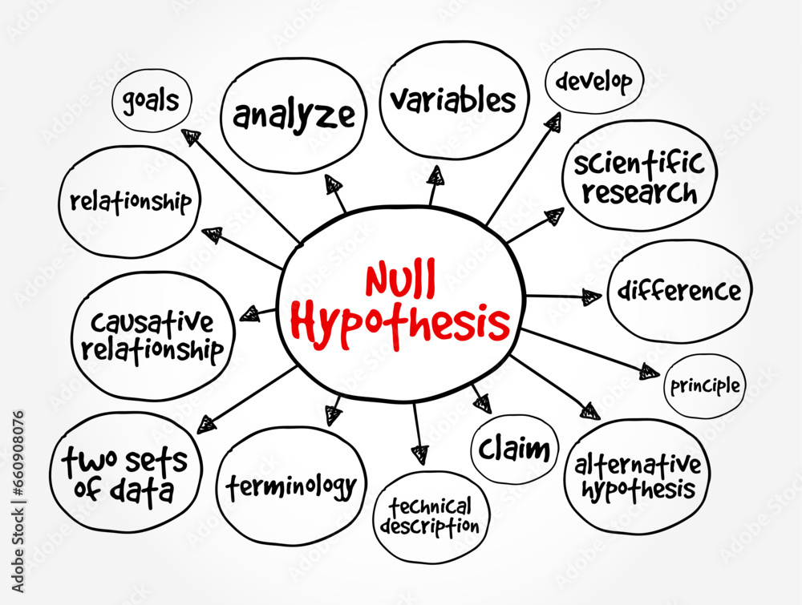
Null Hypothesis: The Big Picture

Slide 3
Hypothesis: What is it?
A hypothesis is a supposition (or proposed explanation) of the behavior or relationship of the data based on preliminary or limited evidence.
Additional experiments are to be conducted to validate, affirm, or negate the hypothesis.
Radom Factors. Factors that can not be controlled.
A plant growth doesn’t solely depend on fertilizer or soil condition only. It may depend on weather to genetics.
Recovery from a disease may depend how prepared the patient is. Factors include immunity, stress, exercise, food habits, genetics, etc.

Slide 4
Null Hypothesis: What Is It?
The change between hypothesis and alternative hypothesis is zero.
Example:
Plants require fertilizer for healthier growth (Hypothesis)
Plants do not require fertilizer for healthier growth (Alternative Hypothesis)
Run experiments on hypothesis and its alternative hypothesis.
If the probability distribution difference (p-value) between the two is:
P-value <= 0.05 (or 5%):
Reject the null hypothesis. Original hypothesis may not be valid.
P-value > 0.05 then:
Accept the null hypothesis ➔ alternative hypothesis is valid

Slide 5
Hypothesis
Drug A
Preliminary Data
Virus
20
18
9.25
Drug B
Time to Recover (hours)
15
Hypothesis:
Patients tested for Drug A recovered 9.25 hours faster than those tested for Drug B
8

Slide 6
Hypothesis (Testing)
Preliminary Data
Experiment 1
- - - - -
Experiment 10
20
18
9.25
Time to Recover (hours)
15
8
Drug B is
5 hrs faster
Drug B works
8 hrs faster
Reject Hypothesis

Slide 7
Hypothesis Testing in Two-Steps
Create a distribution (H₀) showing what the statistic look like when there is no effect!
Show that the statistic you observed is unlikely to come from the null distribution! (H₁)
Hypothesis:
Patients recovered 15 hours sooner
with Drug A than Drug B
10 experiments showed that Drug B is better than Drug A
Comparison of
Drug A and Drug B on same sample showed no difference
Random Factors that may affect outcome: Patient immunity, eating habits, stress, exercise, family history, genetics, etc.

Slide 8
Recipe for Null Hypothesis
Hypothesis (H₁) Application of bio-fertilizer ‘x’ increases plant growth.
Null Hypothesis (H₀) Application of bio-fertilizer ‘x’ does not increase plant growth.
A p-value is a measure of probability that an observed difference could have occurred just by random chance.
Lower the p-value, greater the statistical significance of the observed difference.
Radom Factors: seed quality, wind, sun light, environment, etc.
Validation
p-value <= 0.05
Not statistically significant.
Accept Null Hypothesis
p-value > 0.05
Statistical significance.
Reject Null Hypothesis
Conduct experiments
Check H₁ for each experiment
Does the experiment contradict with the null hypothesis?
Yes: Reject Hypothesis
No: Fail to reject the hypothesis

